Slide 1

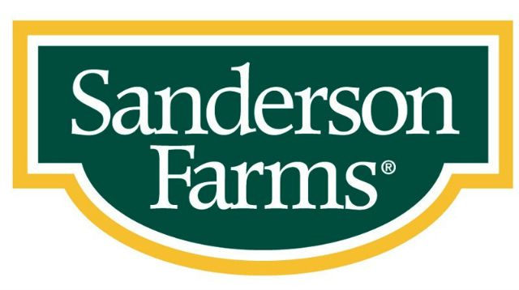

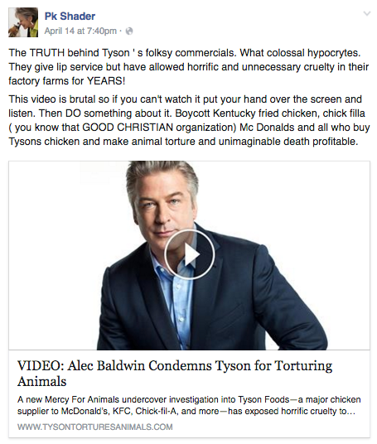
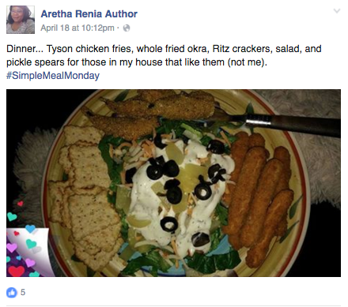
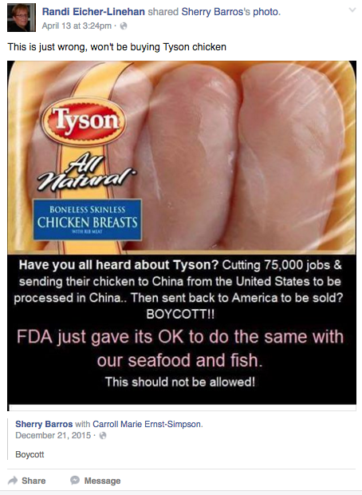
Sanderson Farms Insights for BBDO
Powered by Facebook Topic Data
Run Dates: 4/28/2016 – 5/4/2016
Animal Welfare & Food Safety Insights Summary
PURPOSE: Insightpool aggregated every Facebook interaction relative to ‘Animal Welfare’ and ‘Food Safety’ from 4/28/16-5/4/16. Insightpool was able to record 715k interactions. The purpose of this analysis was to determine the topics and that drive Facebook influencers to talk about the each overarching topic that has previously been identified as important to influencers while also identifying where Antibiotics fits into these conversations. Refer to Page #4 for exact list of keywords used to aggregate the ‘Industry’ conversation.
(1) ’Food Poisoning’ driving the ‘Food Safety’ conversation while ‘Antibiotics’ piggybacking off other topics: The majority of the conversation on Facebook around ‘Food Safety’ consist of conversations about food poisoning in a general sense without antagonizing a specific type of food, food brand, or industry. However, brands like Dole suffered increased negative sentiment when a specific disease was associated with their food.
Recommendation: General ‘Food Poisoning’ is not enough to demonize a brand, while outbreaks of specific diseases will quickly turn the audience against the brand who is responsible. Exploit and publicize competitor outbreaks of specific diseases while allocating less time and resources to instances of ‘food poisoning.’ In the case of a Sanderson outbreak, pay attention to headlines with a specific disease.
(2) ’Food Safety’ conversation less to do with click bait and more to do with educating: After seeing the chicken industry conversation being driven by click bait links, Insightpool was expecting to see this trend continue in the ‘Food Safety’ data. However, the conversation did not rely on the audience worrying whether or not their food supply was effected by the latest outbreak/recall. Instead it was much more educational content, of course driven by the agenda of the influencer.
Recommendation: Because the conversation is less reliant on isolated events or posts, the conversation cycle is much more predictable and is more likely to be influenced by an influencer’s post. It is likely that the same rings true about the conversation outside of Facebook. If Sanderson decides to create educational content around the benefits of antibiotic use, Sanderson could further analyze the timing of the conversation to optimize when and how it interjects its educational content. Sanderson’s audience would be most receptive to pro-antibiotic information if it was packaged in a piece of content that informed the reader about food poisoning and how antibiotics reduce the chance of it. The content should create a problem in the mind of the consumer that is solved by the use of antibiotics. Sanderson would be best served if the content did not have its brand name tied directly to the content, avoiding any possible association with food poisoning. Instead, Sanderson would be benefitted by partnering with a media outlet to generate content similar to the Aol link.
(3) Influencers under the impression that antibiotics are harmful to animals and detrimental to ‘Animal Welfare’: Despite the fact that antibiotics are beneficial to animals for the same reasons they are beneficial to humans, the topic of ‘antibiotics’ was looped into the welfare conversation by posts that discussed the feed of animals and mentioned antibiotics in the same breath as force-feeding in many cases. This misunderstanding made up 85% of the antibiotics conversation while the remaining 15% was associated with the harmful effects antibiotics can have on the environment when the antibiotics contaminate soil and crops by way of animal waste.
Recommendation: Be careful if informing stubborn influencers about the positive impact of antibiotics and animals, because they may be inclined to argue the secondary reasoning, which is much more rooted in science and fact. Despite the fact that the waste is unlikely to impact crops due to the fact that the animals are confined to areas without crops, it may not be a good idea to point out the level of confinement the animals are subject to.
(4) Factory Farming is the primary concern of ‘Animal Welfare’ activists: Factory Farming made up the overwhelming majority of animal welfare conversation. Activists dominate the conversation, while there was little to zero presence from influencers indifferent to factory farming. No brand met the threshold in our most recent ‘factory farming’ data, so this perception is plastered across the entire industry.
Recommendation: Stay away from this conversation entirely. Influencers are passionately against this practice and are not likely to side with ‘the lesser of two evils’.
Tyson vs. Baldwin- Sample Post
Dinner- Sample Post
China (Tyson)- Sample Post

Slide 2
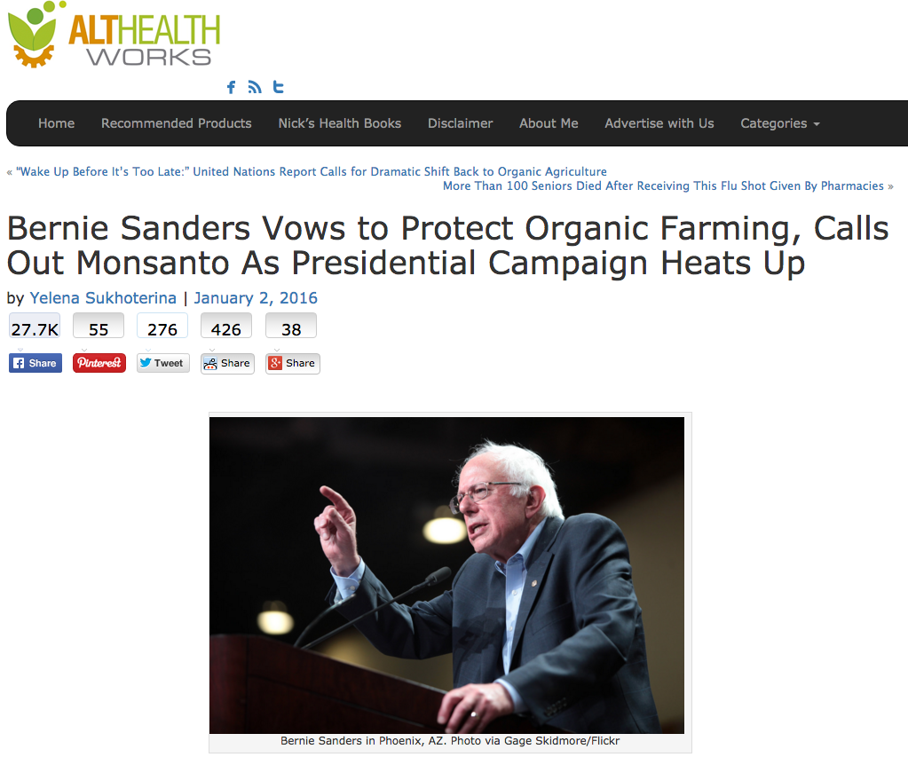
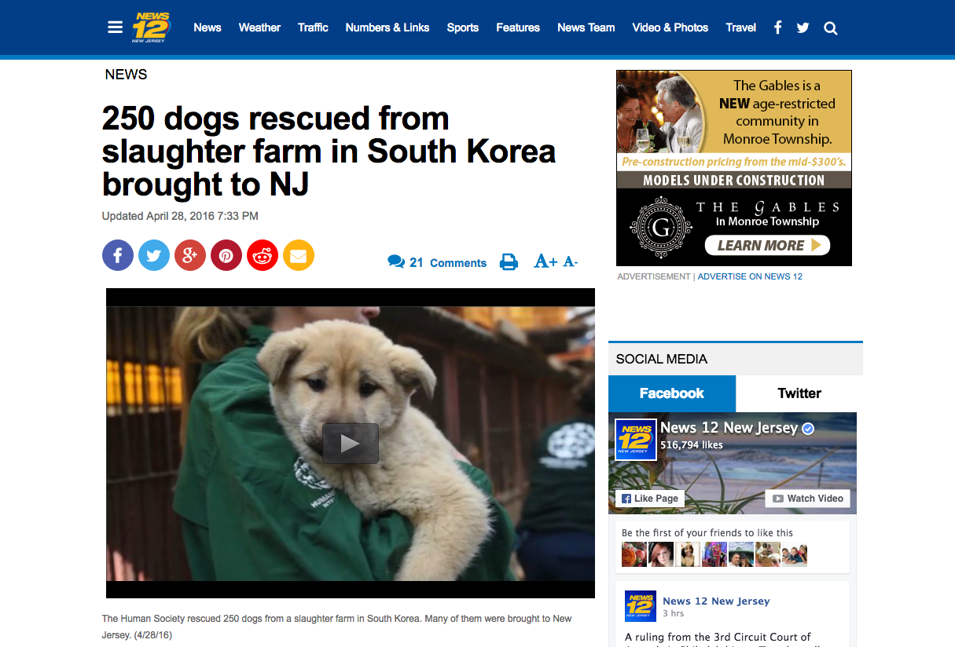
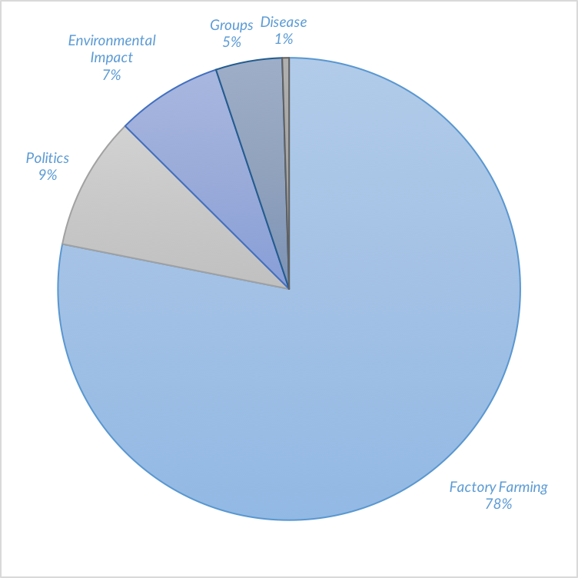
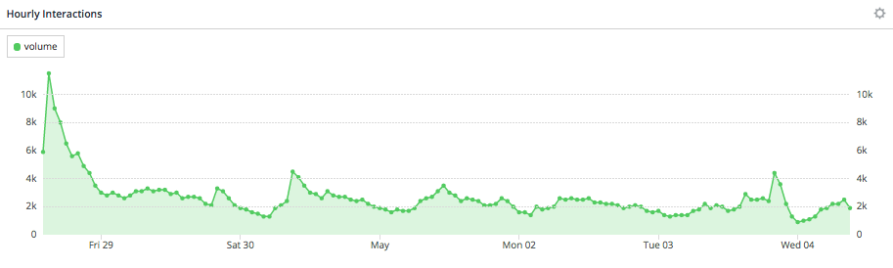
Sanderson Farms Insights for BBDO
Powered by Facebook Topic Data
Run Dates: 4/28/2016 – 5/4/2016
Animal Welfare Conversation Insights
Top 5 Links
Politics is the primary bridge between the ‘Animal Welfare’ and ‘Food Safety’ conversations. Despite the title of the article having to do with ‘Food Safety’, The argument for labeling of foods that include GMOs commonly spews over into the treatment of animals.
47% - Bernie Sanders: Organic Farming
18% - Pinterest: Animal Matters
13% - 250 Dogs Rescued from Slaughter
11% - MFA Blog: School Diciplines Teacher
11% - Animal Welfare Petitions
Custom Topic Analysis
A large portion of the conversation surrounding Tyson came from influencers talking about “Tyson Chicken Nuggets”.
Tyson Foods also under-indexed on positive sentiment, decreasing 7% to 60% relative to the industry average of 67%.
Perdue Farms was largely associated with the word "free" because consumers interacted with and shared coupons on Facebook
Influencers were most motivated to buy Perdue Farms chicken because of it's color and affordable cost
Sanderson Farms made up 1% of the conversation
The majority of Sanderson’s share came from a specific link: http://www.sandersonfarms.com/store-finder/
Conversation Cycle Insights
Daily Volume: Unlike the chicken manufacturing industry, weekends were more popular for the Animal Welfare discussion
Hourly Volume: The conversation typically peaked in the early morning
Peak on April 28th: The largest peak in conversation was on April 28th due to an over-index of fois gras conversation coming from England. One particular piece of content was likely the cause of the surge in conversation based on an over-index of engagements.
372,400
Total Interactions

Slide 3
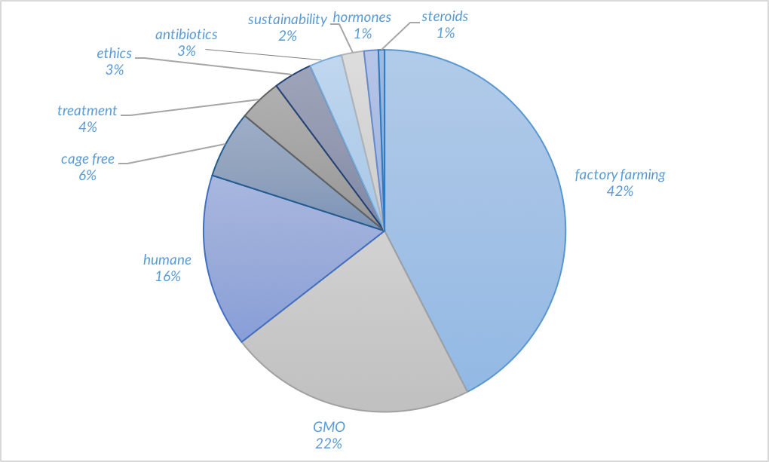
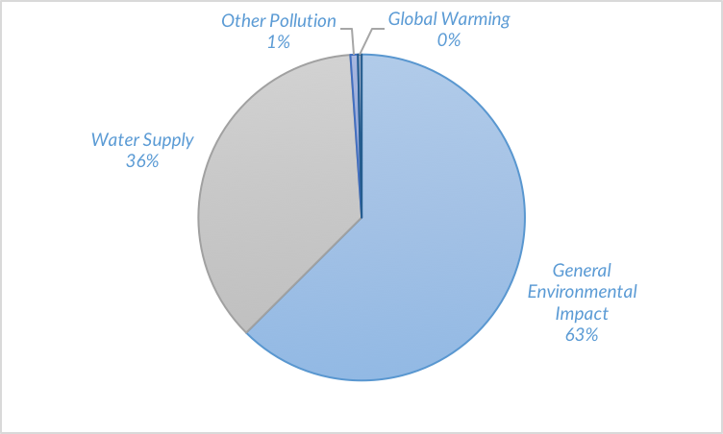
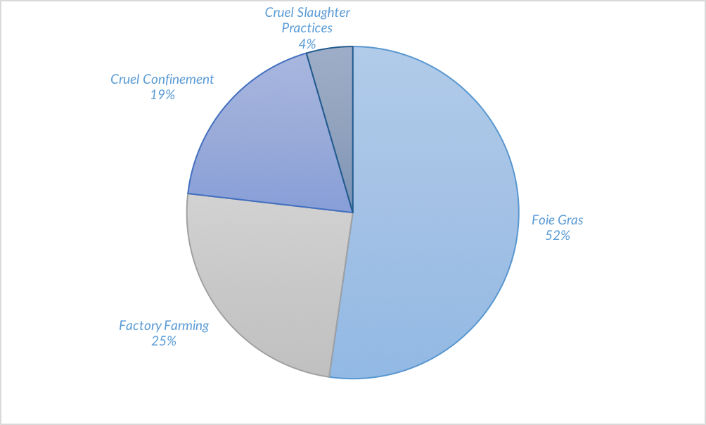
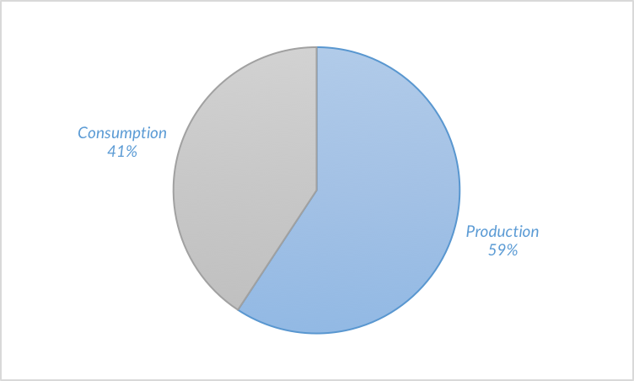
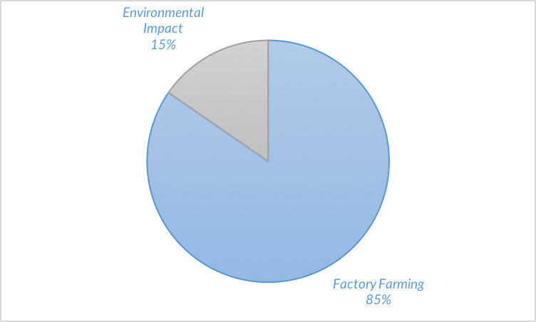
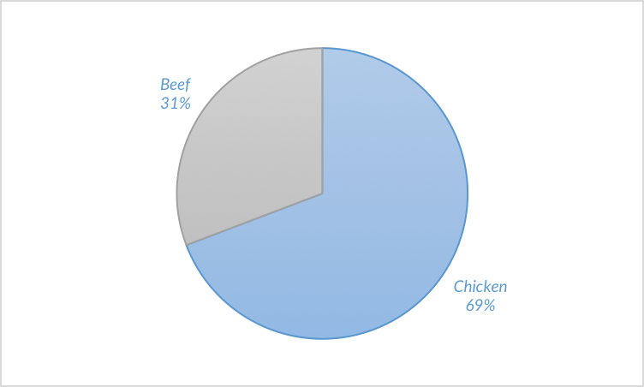
Sanderson Farms Insights for BBDO
Powered by Facebook Topic Data
Run Dates: 4/6/2016 – 4/25/2016
Animal Welfare Custom Conversation Insights
Keywords
Deep Dive: Environmental Impact
Deep Dive: Factory Farming
Antibiotics: Production vs. Consumption
Antibiotics: Categories
Antibiotics: Meat

Slide 4
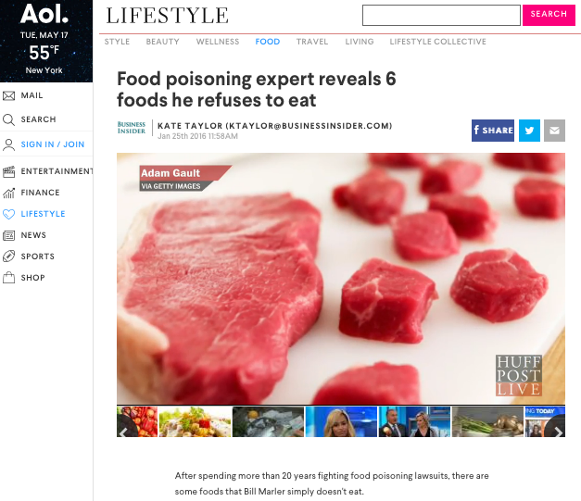
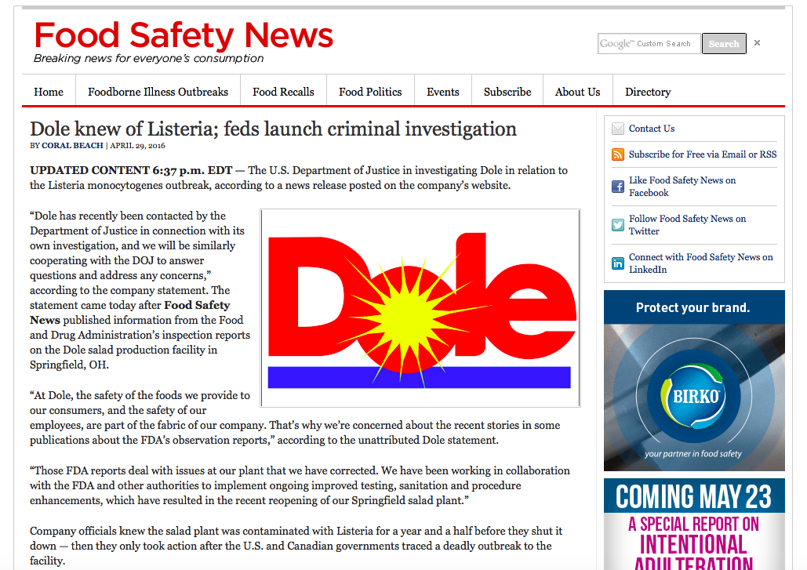
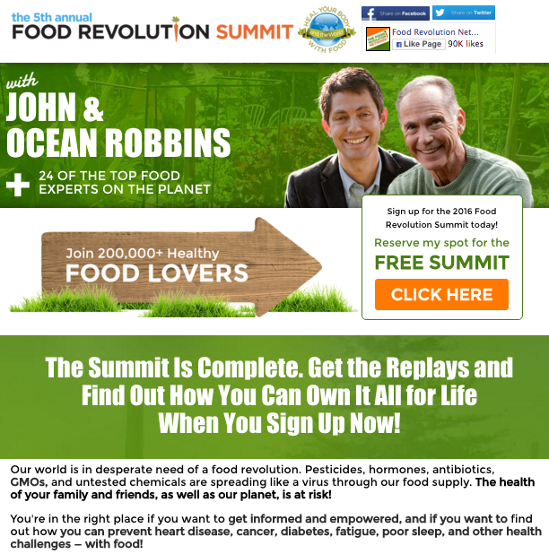
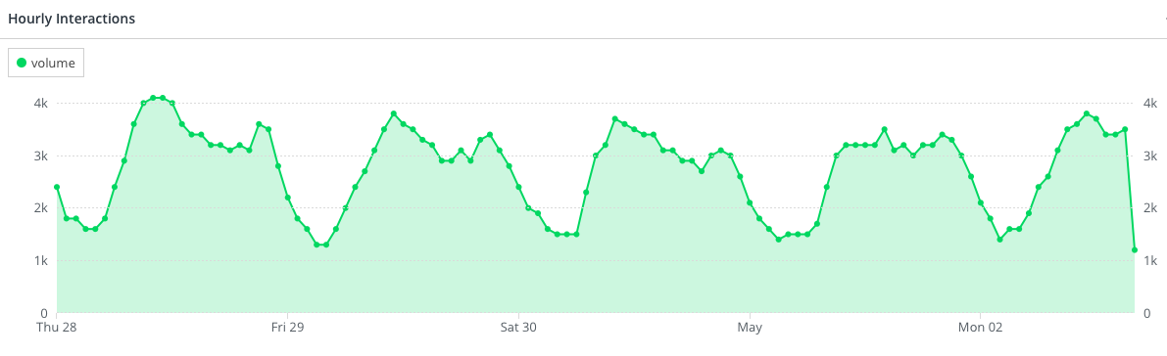
Sanderson Farms Insights for BBDO
Powered by Facebook Topic Data
Run Dates: 4/6/2016 – 4/25/2016
Food Safety Conversation Insights
Top 5 Links
Unlike the previous ‘Chicken Manufacturing Industry’ data, the top five links driving the conversation were not click bait. Instead, the links were less about finding out if an outbreak could have potentially reached your kitchen and more along the lines of educating the public on this topic. This signals that the audience is interested in learning more about food safety and could be receptive to educational content from Sanderson.
41% - Aol: Food Poisoning- 6 Foods
17% - Norovirus Outbreak on Cruise
15% - Food Safety News: Dole Knew of Listeria
14% - WSJ: U.S. Probes Dole
13% - French Listeria Outbreak
Antibiotics Analysis
5.3k interactions of the ‘Food Safety’ conversation were associated with the use of Antibiotics (79% Negative Sentiment)
Posts that mentioned Antibiotics had a higher engagement rate than the ‘Food Safety’ baseline
Unlike most topics within the food safety conversation, ‘Antibiotics’ rarely stood alone as the primary topic of the post
‘Antibiotic Use’ was commonly looped into the ‘Food Safety’ conversation in the same breath as topics like ‘GMOs’ or ‘hormones’
The Food Revolution Summit link was the centerpiece of the discussion
No particular chicken manufacturing brand was associated with the ‘Antibiotics’ conversation
Conversation Cycle Insights
Daily Volume: The conversation cycle in terms of total volume per day and volume distribution throughout the day did not vary from weekends to weekdays. Unlike many Facebook conversation topics, the conversation behaved similarly each day the conversation was recorded. Interestingly, this signals that the conversation is much less likely to be impacted by isolated events or posts than other conversations like ‘Animal Welfare’.
Hourly Volume: The volume typically peaked between 9-10 AM EDT while experiencing another bump in interactions 12 hours later at 9-10 PM EDT
342,600
Total Interactions

Slide 5
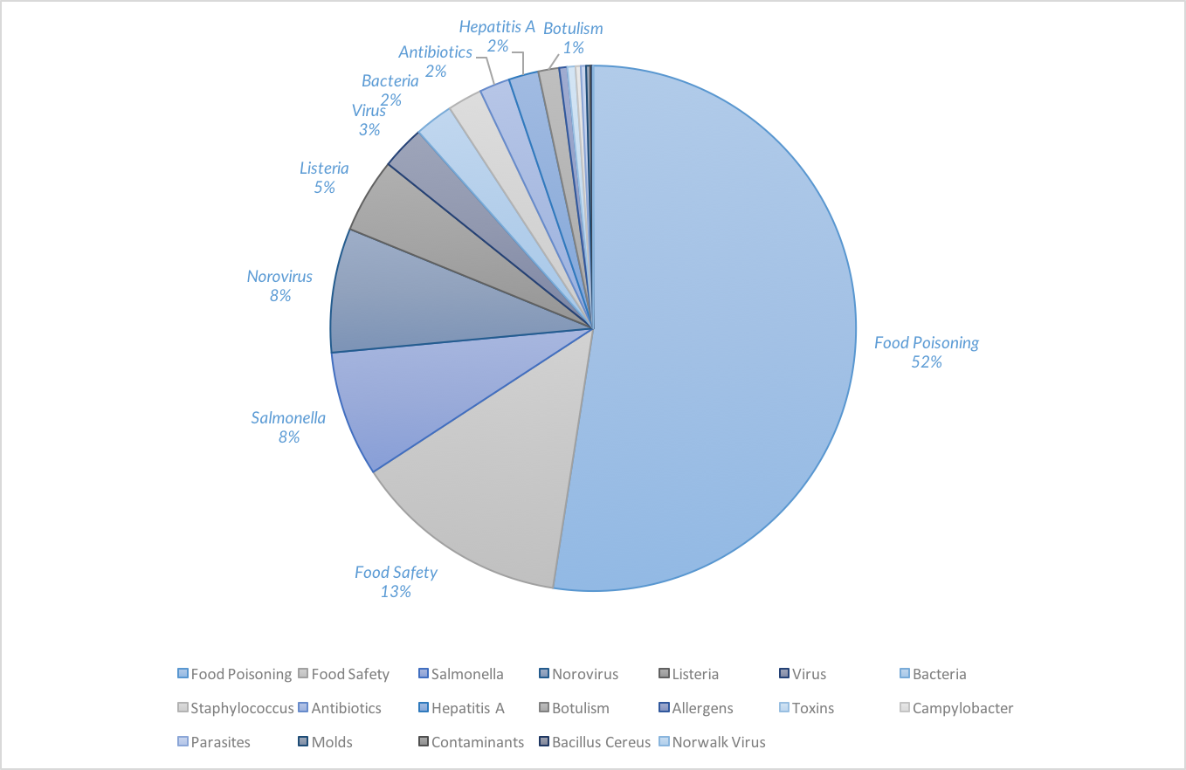
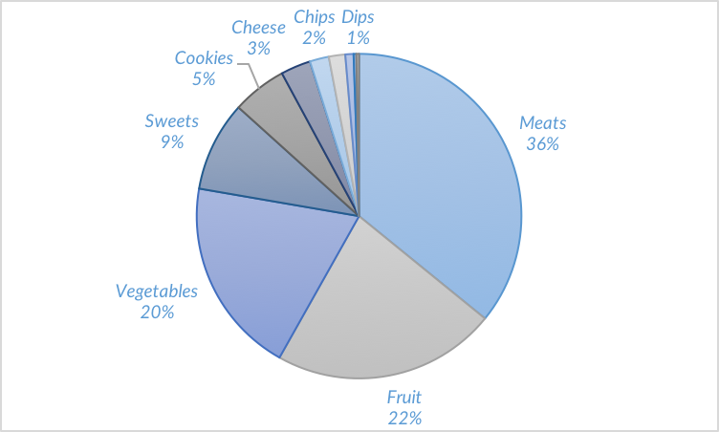
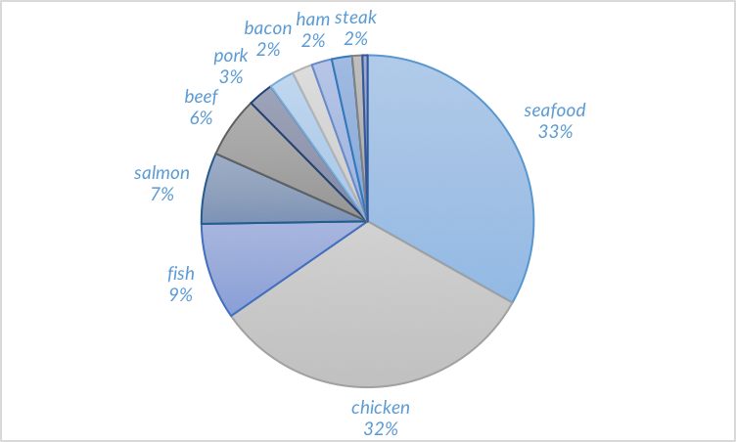
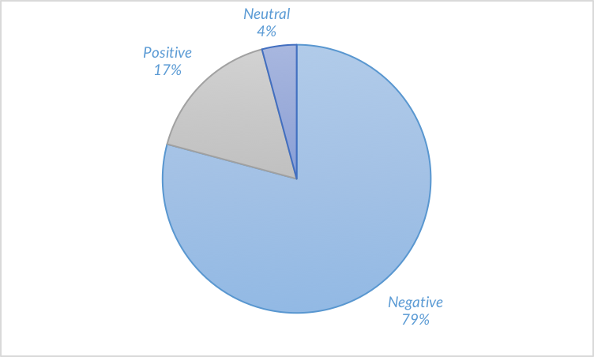
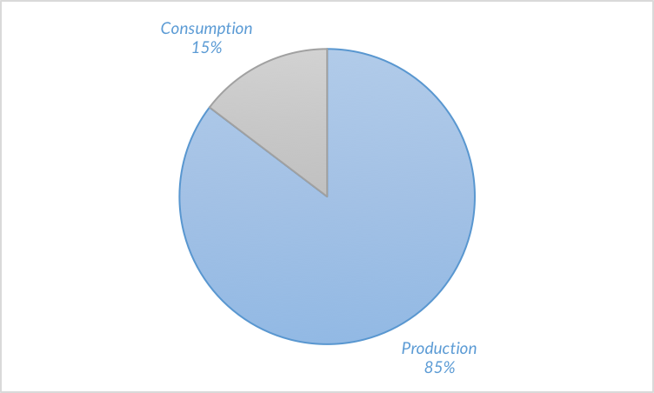
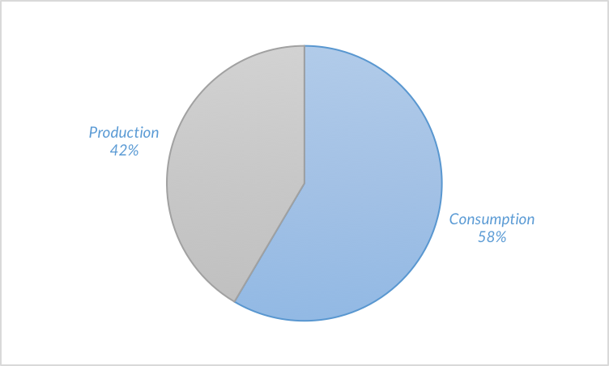
Sanderson Farms Insights for BBDO
Powered by Facebook Topic Data
Run Dates: 4/6/2016 – 4/25/2016
Food Safety Custom Conversation Insights
Topics
Food
Deep Dive: Meats
Sentiment Towards Antibiotics
Antibiotics: Production vs. Consumption
Production vs. Consumption

Slide 6
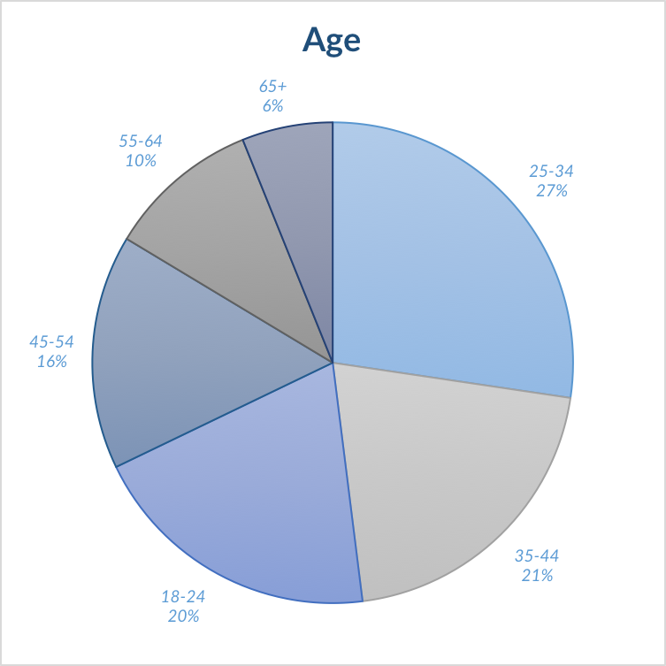
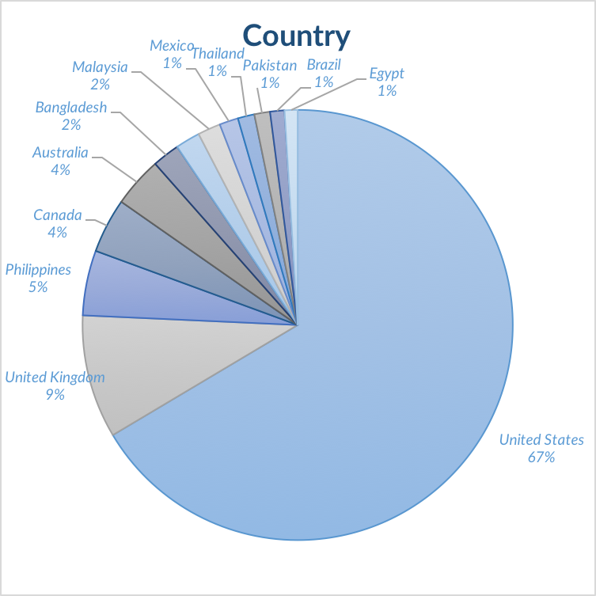
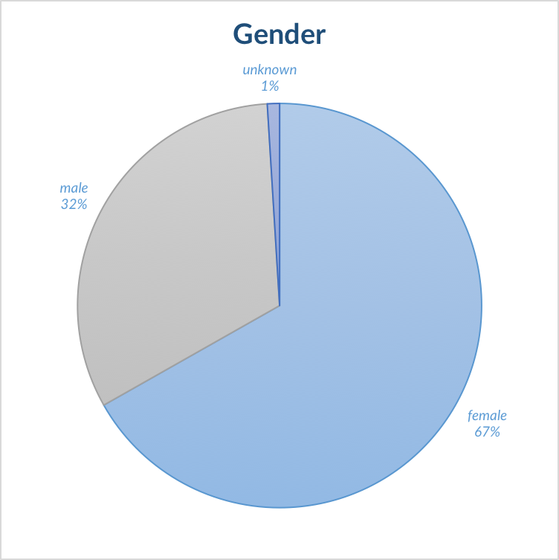
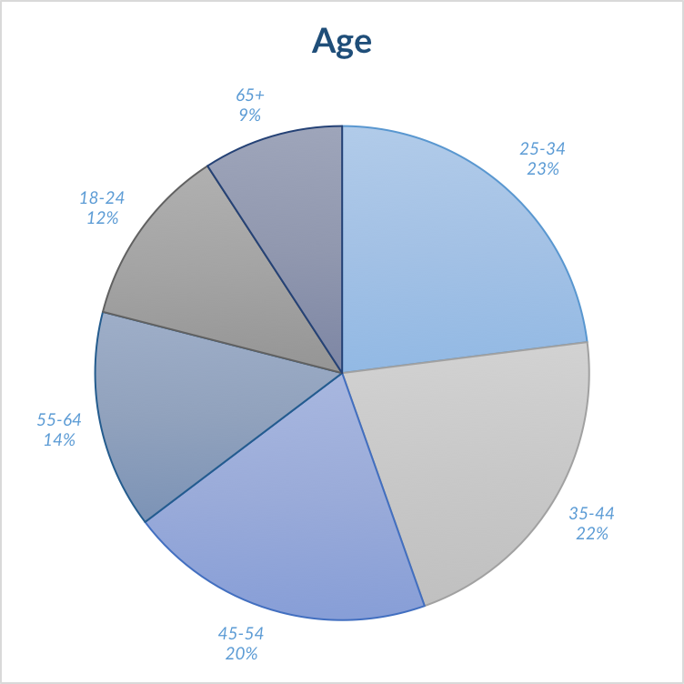
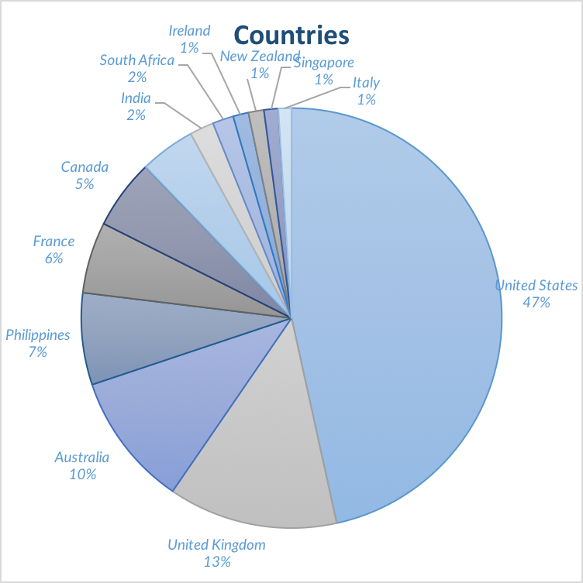
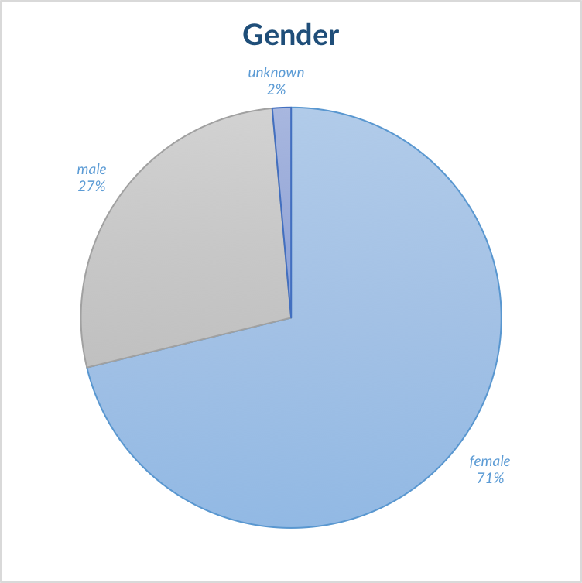
Sanderson Farms Insights for BBDO
Powered by Facebook Topic Data
Run Dates: 4/6/2016 – 4/25/2016
Food Safety Demographic Insights
Query
fb.all.content contains_any "food Safety, food poisoning, food poison, ecoli, Bacillus cereus, Botulism, Campylobacter, Clostridium perfringens, e coli, E. coli, Hepatitis A, Listeria, Norovirus, Norwalk Virus, Salmonella, Shigella, Staphylococcus, Vibrio Infections, Vibrio Infection”
OR
(fb.all.content contains_any "bacteria, virus, viruses, Parasites, Parasite, Allergen, Allergens, Molds, Mold, Toxins, toxin, Contaminants, Contaminant" AND fb.all.content contains_any "in food, in the food, in their food, recall, recalled" AND NOT fb.all.content contains_any "i recall, you recall"))
Animal Welfare Demographic Insights
Query
fb.all.content contains_any "animal welfare, factory farming, factory farm, factory farms, factory farmer, farm animal protection, animal confinement, cruel confinement, intensive-confinement systems, intensive confinement systems, Foie gras, humane eating”
OR
(fb.all.content contains_any "veal, chickens, hens, chicken, breeding pigs, breeding pig" AND fb.all.content contains_any "inhumane, humane, cage, cages, confinement, confine, confines, cruel, cruelty, torture, tortures, torturing, tortured, forcefed, force fed, force-fed, forcefeed, force feed, force-feed")

